Slide 1
Suffering, Memory, and Compassion
A Buddhist Variation on the Ethics of Memory

Slide 2
Unique Inescapable Ruptures
cataclysm
“point of no return”
individuals, community, world
central to identity formation
memory/amnesia

Slide 3
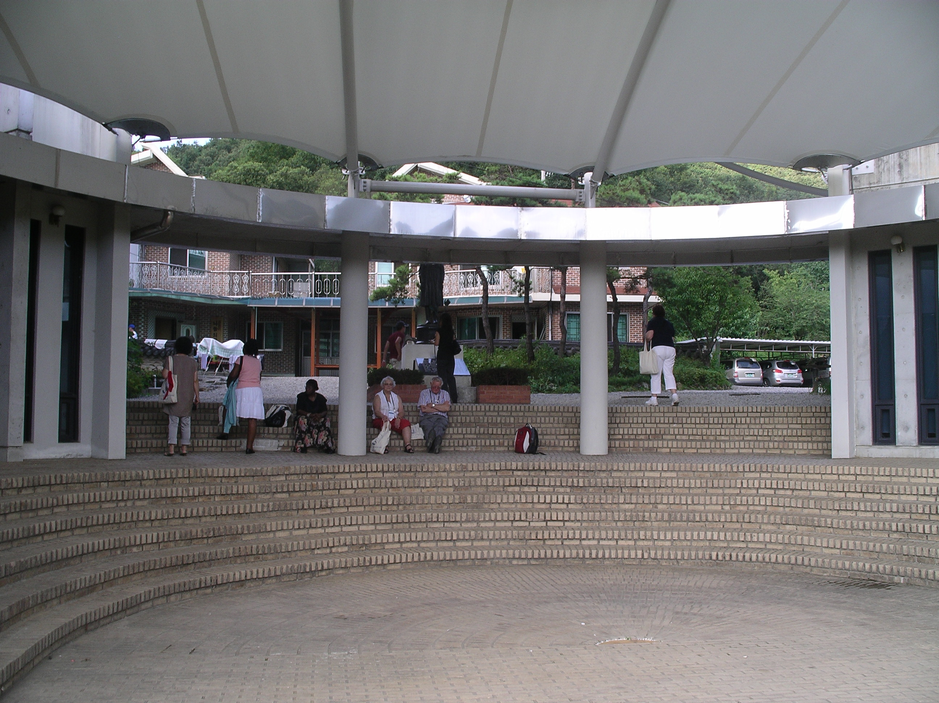
4 examples

Slide 4
Max Frisch: Nun singen sie wieder
Frau: “Das Kind wird nichts mehr von dem Krieg wissen wenn es gross ist. Denken Sie das! .. Überall dort, wo sich niemand mehr an den Krieg erinnern kann, dort fängt das Leben wieder an!”
Jemand: “Oder der nächste Krieg.”
Frau: “Wieso?”
Jemand: “Weil sich niemand mehr selber daran erinnern kann.”
Woman: "The child will not know anything of the war when it is grown up. Think about that! .. Wherever no one can remember the war, there Life begins again!”
Someone: “or the next war.”
Woman: “Why?”
Someone: “Because no one is there to remember it.”

Slide 5
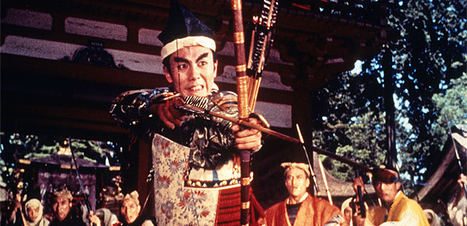
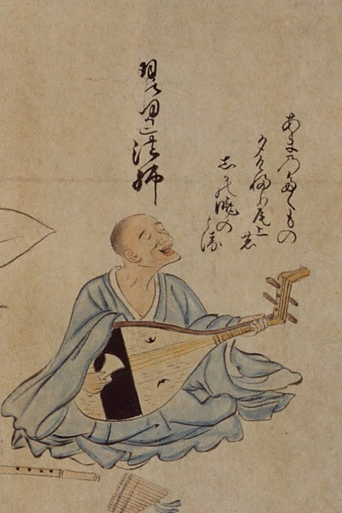
Biwa-Hōshi (琵琶法師)
itinerant monks
平家物語 – Tale of Heike
Genpei (源平) war
The bell in the monastery garden rings, preaching everything changes constantly
human life is just like a dust blown by the wind
narrative ends in a monastery garden

Slide 6
“ethics of memory”
“The difference between dwelling on humiliation and not on recognition is not the same sort of difference as that between seeing the cup half empty and seeing it half full. The difference, I believe, cuts deeper. Is it not injustice rather than justice that ‘hurts us into politics’?” (Margalit, Ethics of Memory, 2004, 104)

Slide 7
commemoration and memorials
“founding day”
significant events and people
tragedies we (our community) suffered
what about what we (our community) did to others?
what about the events we rather forget/deny?

Slide 8
9/11 (1938+1989)

Slide 9
but what do we forget

Slide 10
commemoration and judgment
“extrovert criticism”
critique/judgment of other
essentializes one event
bifurcates humanity
negates the other
affirms the self
“introvert criticism”
critique/judgment of self
essentializes one event
bifurcates humanity
negates the self
affirms the other

Slide 11
why Buddhism?
suffering, impermanence, selflessness
karma
memory → wisdom
compassion
not as moral imperative but as metaphysical condition
emptiness
provisionality
“lishiwuai – shishiwuai”
“one-and-yet-many”

Slide 12
Running on karma

Slide 13
the framework: ethics of expression
3 terms: world, individual, and specific
“one world” (totality), infinity of individuals (activity), plurality of specifics (identity)
each specific is a full but not complete expression of the world
=> every individual is necessary
=> solidarity of equals
=> modality of encounter is ethics of expression
=> identities are particular, in-relation, and provisional
“The specific has to be understood as the mutual determination of the individual and the world. At the same time, it becomes the fundamental mediation in its own self-alienation. Insofar as it becomes nothing, it mediates between the individual and the world. At the same time, it has to be thought as that which determines the world as its particular (expression).”

Slide 14
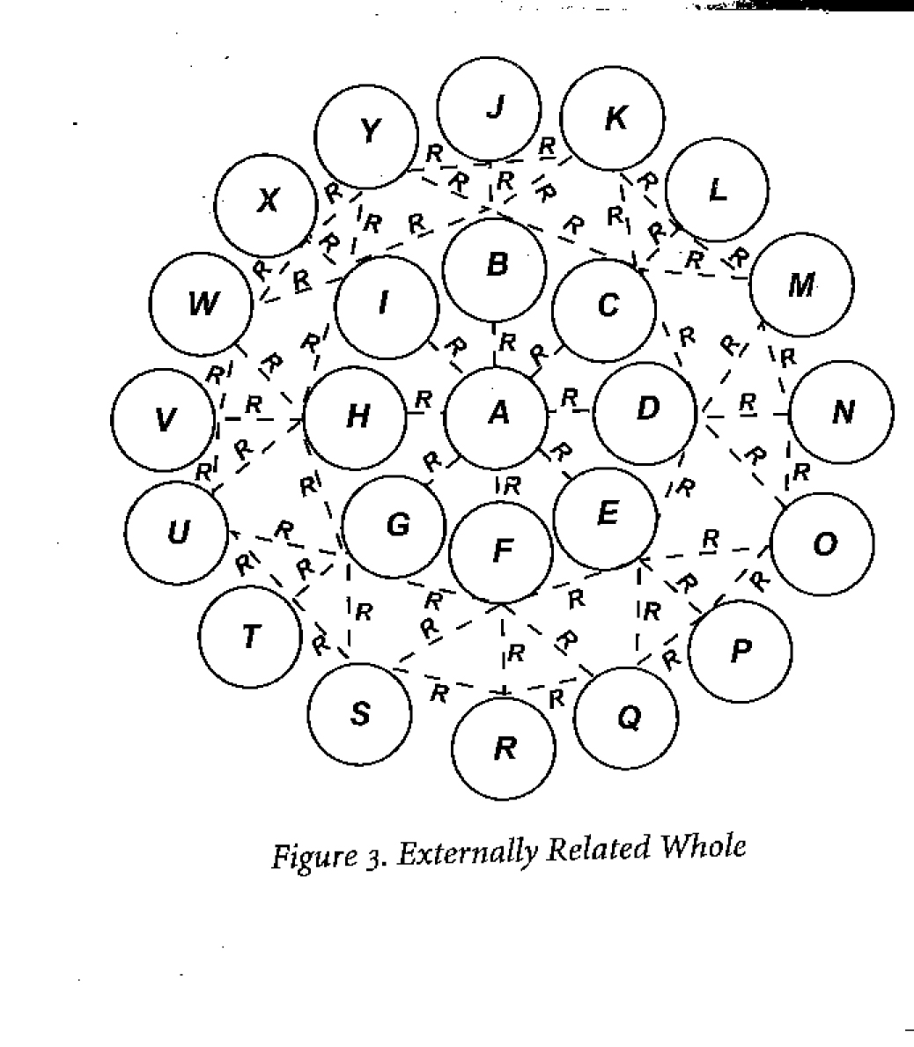
2 visions of the global community
Leibniz
Nishida

Slide 15
approaches in comparison
essentialism | ethics of expression
substance | co-dependent arising
essential identity | provisional identity
isolation | interconnectedness
Truth vs. Falsity | narratives (“small discourses”)
Us vs. Them | solidarity of equals
justice | ambiguity of existence
“ethics of judgment” | “ethics of understanding”

Slide 16
Caveat
power structure
Hegel: master – slave
victims and victimizers are equal as human beings but not in political reality
language used to analyze power structure shaped by power structure (self-determination)
“conditions” is one of power differential
“ethics of understanding” aims at understanding and correcting this power differential

Slide 17
the case of Nanjing
December 13, 1937: attack on Nanjing
Guomindang moves capital to Chongqing
1939: Ah Long’s Nanjing depicts Chinese at victims
October 1, 1949: foundation of P.R.C.: “heroic narrative”
1990s: rhetoric of victimization: “not forgetting” (wuwang) of “national humiliation” (guochi)
1983 plans for memorial hall
1997: Iris Chang’s Rape of Nanking
1985 completion, 1997 and 2007 expansion

Slide 18
Rape of Nanking

Slide 19
Nanjing Massacre

Slide 20
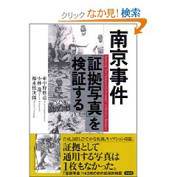
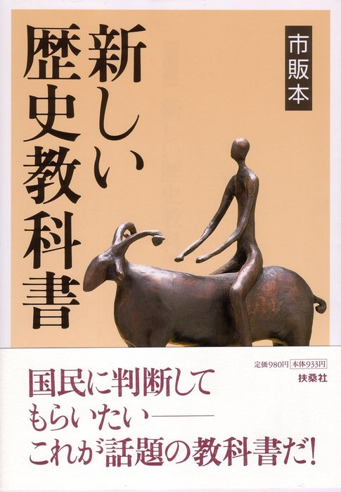
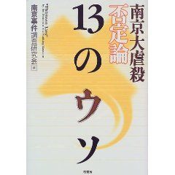
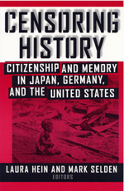
at the center of the controversy
issue | “Chinese” | “Japanese”
name | “rape of Nanjing,” | 南京大虐殺 vs. 南京事件: massacre vs event
number | > 300,000 | about 50,000
百人斬り競争 | exemplifies brutality | construction by media
pictures | proof of atrocities | Chinese propaganda
testimonies | proof of facticity of massacre | subjective and ideologically corrupt
Tokyo tribunals | insufficient (Unit 731) | anti-Japanese prejudice

Slide 21
the role of education?

Slide 22
four types of narratives

Slide 23
City of Life and Death

Slide 24
4 ideologies
premodern | modern | postmodern | postglobilzation
communalism | globalism | self-determinism | cosmopolitanism
nationalism | colonialism | localism/cultural relativism | humanism
specific | world | individual | dialectics of expression
limited being-with | being-with (courage to be a part) | courage to be oneself | to be oneself and to be a part
nativism | universalism | relativism | ethics of understanding
ethnicity | identity | difference | identity/difference
feeling | rationality | personal experience | all modalities
commemoration | education | empowerment of victims | memory as mimesis
community not the world | world neither static nor completed | decentralization | complexity
dualism | monism | pluralism | non-essentialism

Slide 25
another Caveat
“infinite deferral” (Chinul’s gradualism, Derrida, Takahashi): justice, peace, equality are limit functions
paradox of revolution (Takahashi’s “infinite dialectics”): “the new boss is the same as the old boss” (The Who)
existential ambiguity: “Nishida’s “purity is not different from impurity”)
OR
“There was once a boy who dreamed of being a hero. Who believed sincerely in the battle to banish darkness from a world of light. But light and darkness are equal. And where one exists so too must the other. And when the boy realized this, he had taken the first step towards becoming a true hero.” (Records of the Lodoss War)

Slide 26
a plea for a paradigm change
essentialism → non-substantialism
ethics of judgment → ethics of understanding
simple identity → complex identity
moralistic certainty → existential ambiguity
recognition that identities are fluid and provisional
knowing oneself - understanding the other 知自解他
realization that suffering is both personal and impersonal
transformation through memory

Slide 27
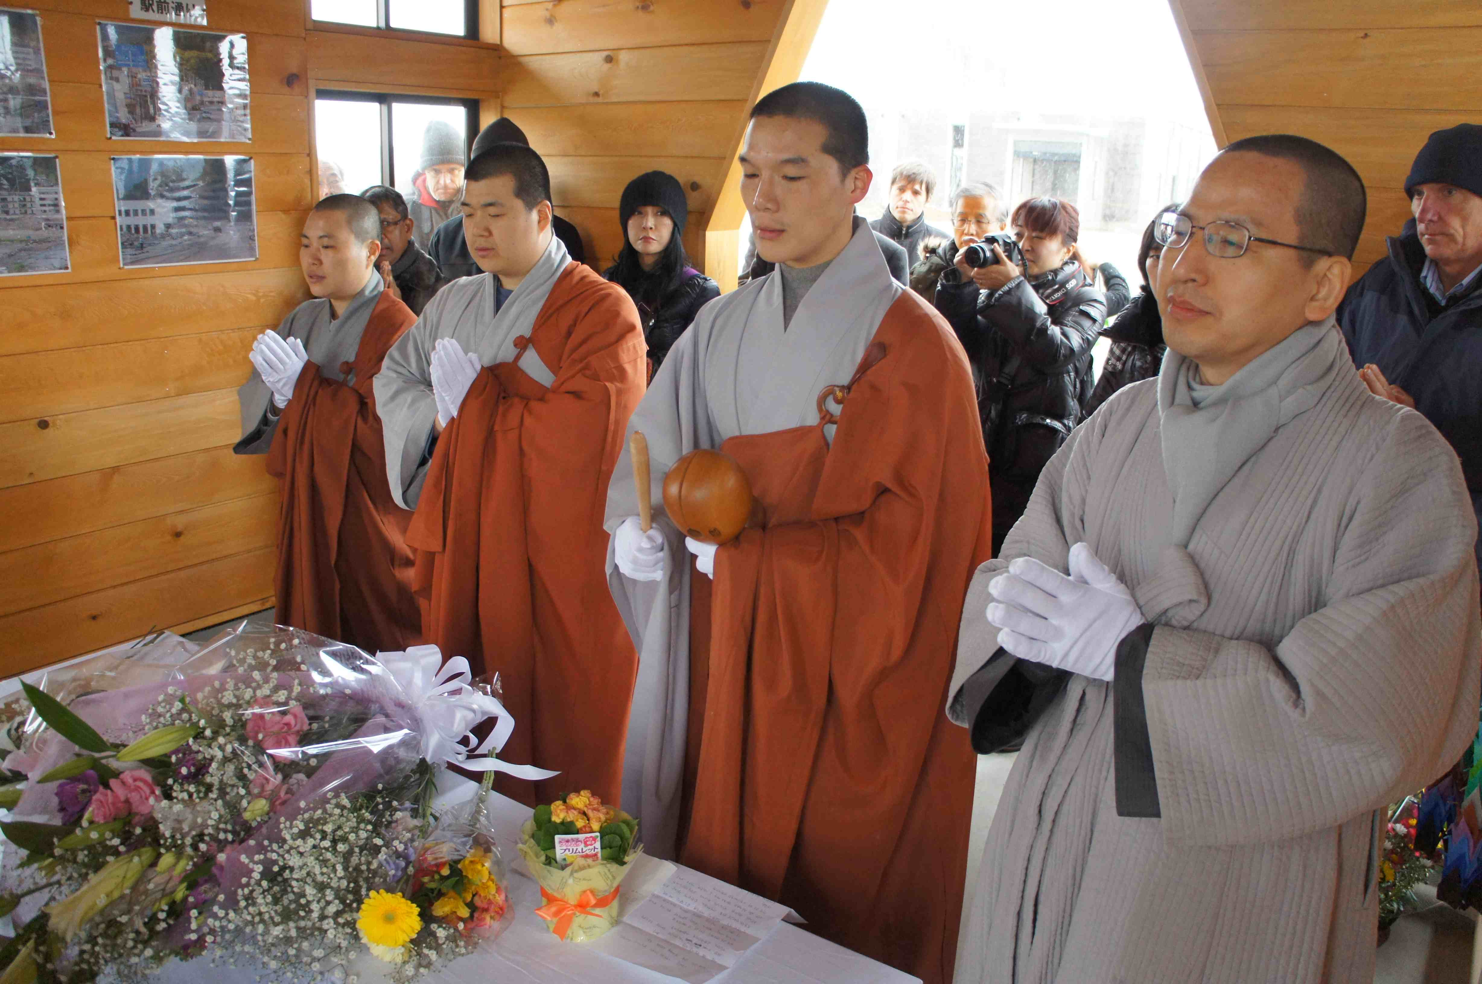
how to remember?

Slide 28
What is Butō?

Slide 29
4 forms of commemoration
commemoration | education | witness accounts | memory as mimesis
communal | universal | personal | humanistic
feeling of belonging | moral reasoning | empowerment/empathy | understanding
patriotic education | peace education | diverse | non-substantial
Us vs Them | one humanity | many standpoints | complexity
ritual to enforce identity | moral training | giving voice to those silenced by history | transformation towards humanity

Slide 30
rethinking ethics of memory
memory of injustice to engender transformation
inclusion of multiple narratives
Hanh’s principle’s of reconciliation: remembrance, non-stubbornness, and voluntary confession (Being Peace)
understanding the conditions, power structures, tragedies
understanding the standpoint of the “other”
acceptance of existential and moral ambiguity
deconstruction of the US-vs-Them rhetoric (Takahashi’s “dialectics of dialectics”)
deconstruction of moralism
ethics as “unceasing working”

